Slide 1
Hibernate
Hibernate is ORM tool. Object-relational mapping or ORM is the programming technique to map application domain model objects to the relational database tables. Hibernate is java based ORM tool that provides framework for mapping application domain objects to the relational database tables and vice versa.
Some of the benefits of using Hibernate as ORM tool are:
Hibernate supports mapping of java classes to database tables and vice versa. It provides features to perform CRUD operations across all the major relational databases.
Hibernate eliminates all the boiler-plate code that comes with JDBC and takes care of managing resources, so we can focus on business use cases rather than making sure that database operations are not causing resource leaks.
Hibernate supports transaction management and make sure there is no inconsistent data present in the system.
Since we use XML, property files or annotations for mapping java classes to database tables, it provides an abstraction layer between application and database.
Hibernate helps us in mapping joins, collections, inheritance objects and we can easily visualize how our model classes are representing database tables.
Hibernate provides a powerful query language (HQL) that is similar to SQL. However, HQL is fully object-oriented and understands concepts like inheritance, polymorphism and association.
Hibernate also offers integration with some external modules. For example Hibernate Validator is the reference implementation of Bean Validation (JSR 303).
Hibernate is an open source project from Red Hat Community and used worldwide. This makes it a better choice than others because learning curve is small and there are tons of online documentations and help is easily available in forums.
Hibernate is easy to integrate with other Java EE frameworks, it’s so popular that Spring Framework provides built-in support for integrating hibernate with Spring applications.
I hope all the above benefits will convince you that Hibernate is the best choice for your application object-relational mapping requirements.

Slide 2
Hibernate Architecture
Hibernate is a middleware used for object-relational mapping and for performing efficient object persistence. To understand about the architecture of Hibernate, let's first take a look at how Hibernate fits in the development of an application, between an application and the database server.
A Java application code comprises of all the classes that define the business logic of application. These classes communicate with the Hibernate.
Next comes, the Hibernate and its core interfaces, using which we could persist(store and retrieve) the objects of our business layer classes by communicating with the database server.
Hibernate uses the Java core API, Java Database Connectivity(JDBC), Java Transaction API(JTA), Java Naming and Directory Interface(JNDI) to communicate with database in order to persist the state of object by performing create, read, update, delete(CRUD) operations.

Slide 3
Need of Hibernate Framework
Hibernate is used to overcome the of limitations of JDBC like:
JDBC code is dependent upon the Database being used i.e. our persistence logic is dependent, because of using JDBC. Here we are inserting a record into Employee table but our query is Database software-dependent i.e. Here we are using MySQL. But if we change our Database then this query won’t work.
If working with JDBC, changing of Database in middle of the project is very costly.
JDBC code is not portable code across the multiple database software.
While working with JDBC, There is no support Object-level relationship.

Slide 4
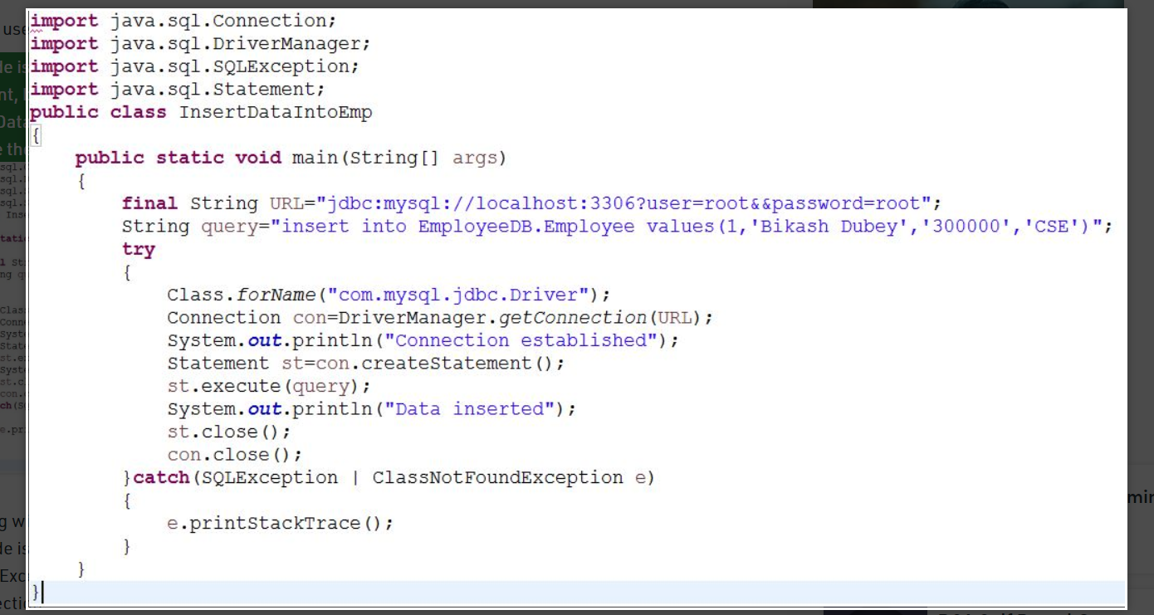

Slide 5
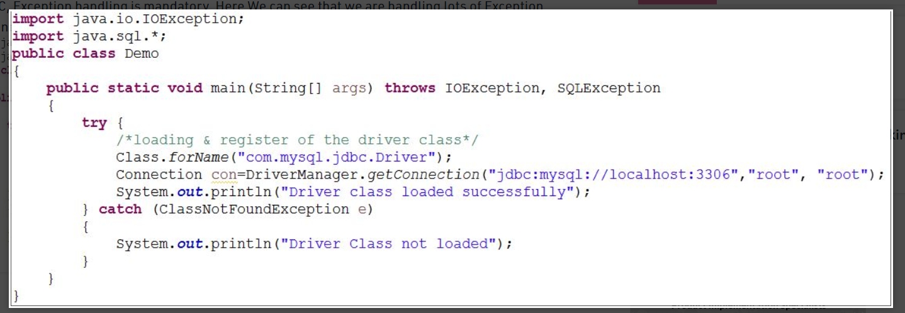
5) In JDBC, Exception handling is mandatory. Here We can see that we are handling lots of Exception for connection.

Slide 6
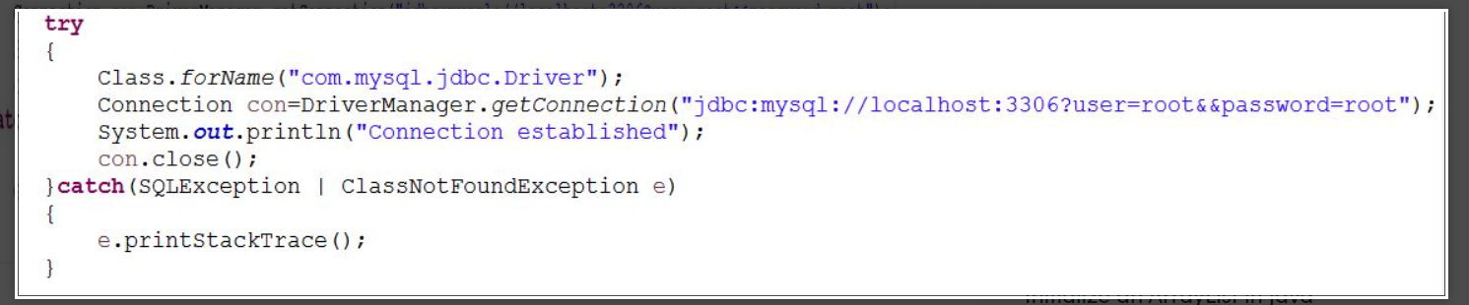
6) In JDBC, there occurs a Boilerplate problem i.e. For each and every project we have to write the below code. That increases the code length and reduce the readability.

Slide 7
Functionalities supported by Hibernate framework
Hibernate framework support Auto DDL operations. In JDBC manually we have to create table and declare the data-type for each and every column. But Hibernate can do DDL operations for you internally like creation of table, drop a table, alter a table etc.
Hibernate supports Auto Primary key generation. It means in JDBC we have to manually set a primary key for a table. But Hibernate can this task for you.
Hibernate framework is independent of Database because it supports HQL (Hibernate Query Language) which is not specific to any database, whereas JDBC is database dependent.
In Hibernate, Exception Handling is not mandatory, whereas In JDBC exception handling is mandatory.
Hibernate supports Cache Memory whereas JDBC does not support cache memory.
Hibernate is a ORM tool means it support Object relational mapping. Whereas JDBC is not object oriented moreover we are dealing with values means primitive data. In hibernate each record is represented as a Object but in JDBC each record is nothing but a data which is nothing but primitive values.

